Slide 1

Brokerage House
Client information
(personal info, ledger, portfolio, buy/sale)

Slide 2
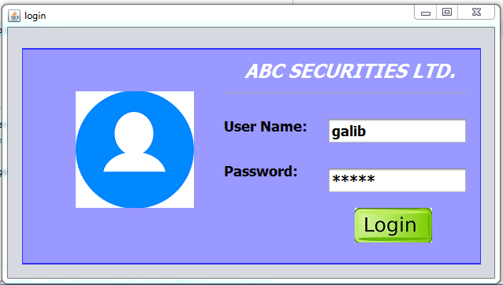
Login page

Slide 3
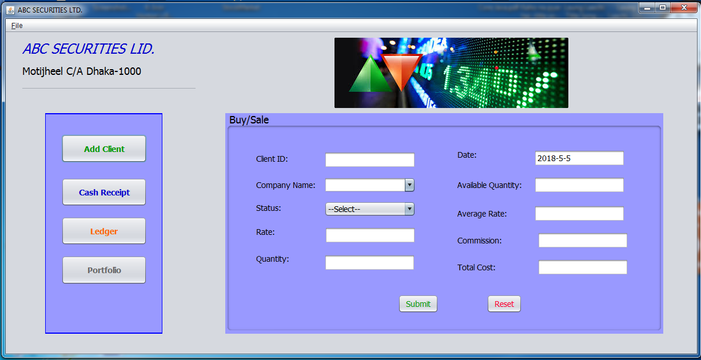
Home Page

Slide 4
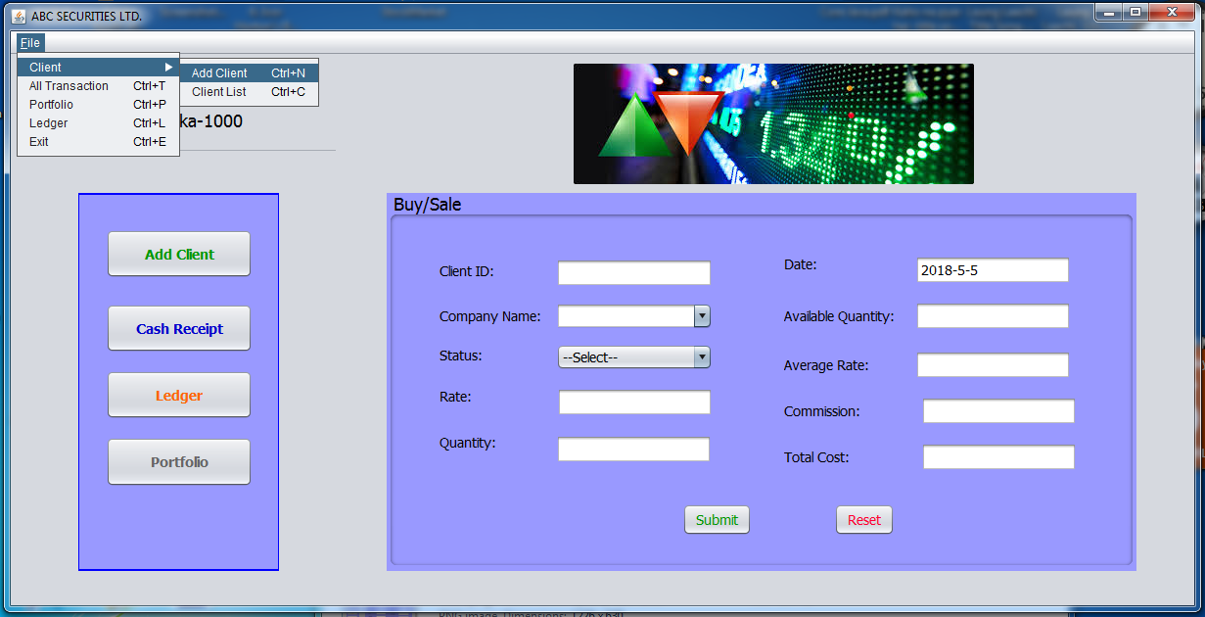
Go to Client Registration Form

Slide 5
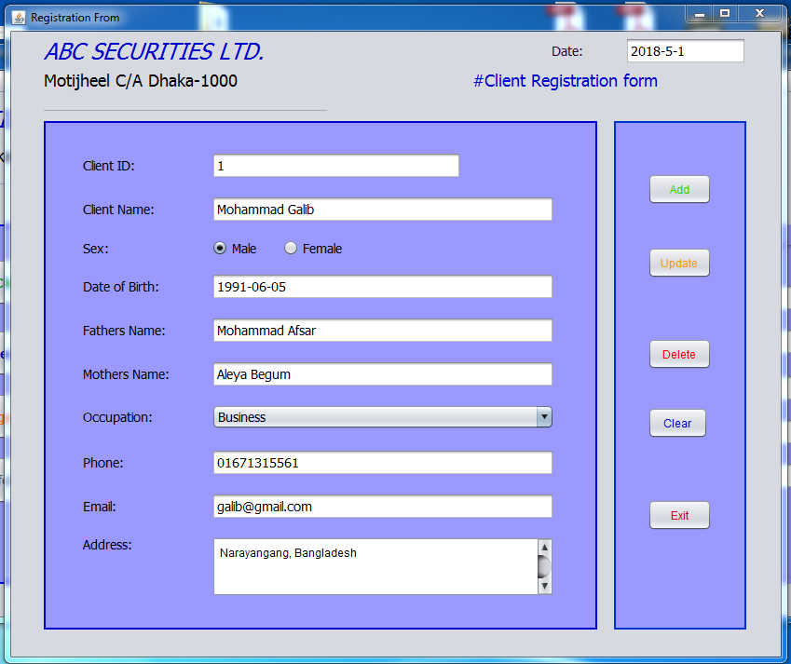
For adding new client
For Update client information
For deleting client
Clear all field in this form
Exit from this form

Slide 6
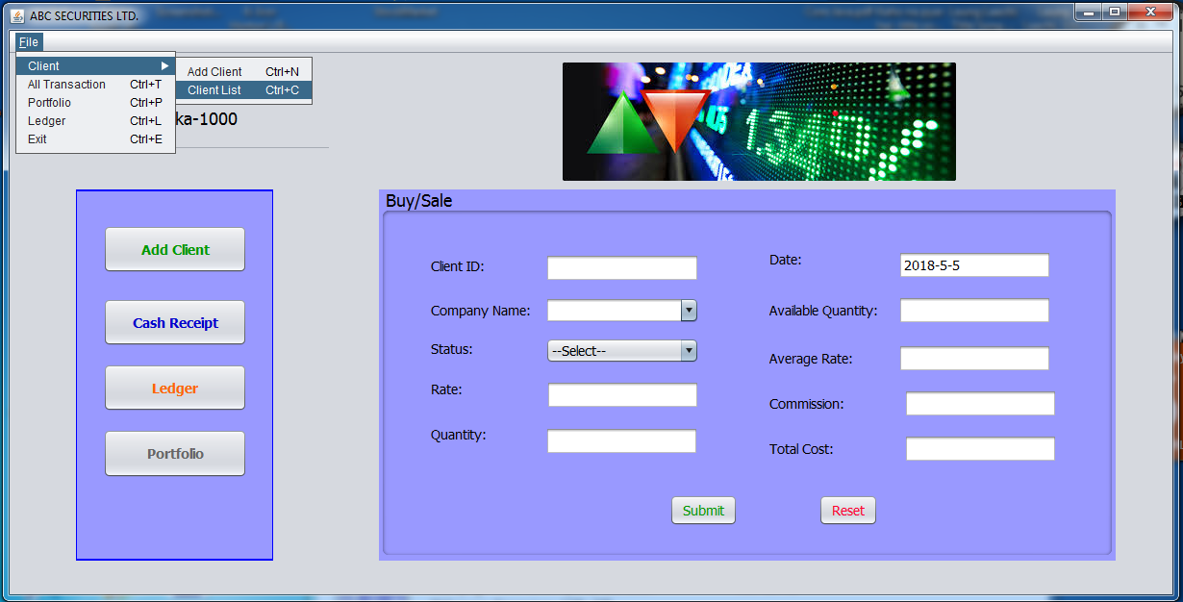
Go to Client List Form

Slide 7
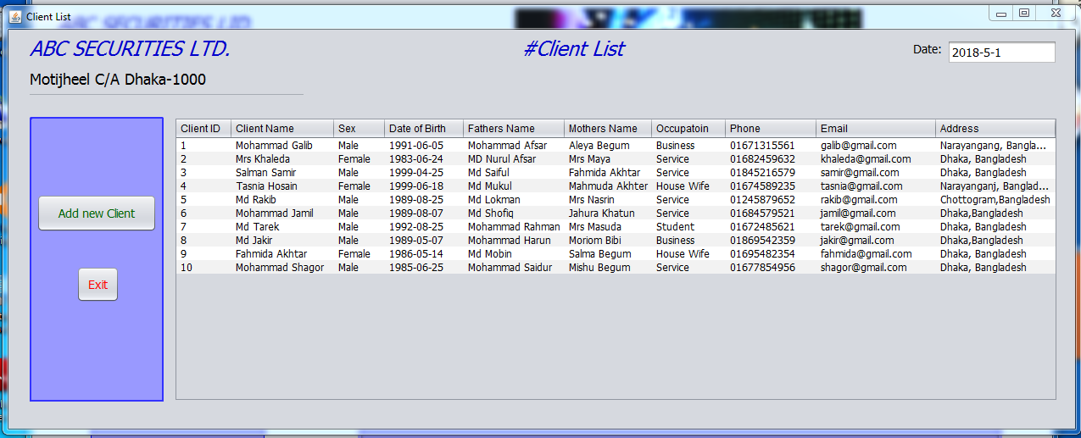
Client Personal information
Go to Client Registration Form
Exit from this form

Slide 8
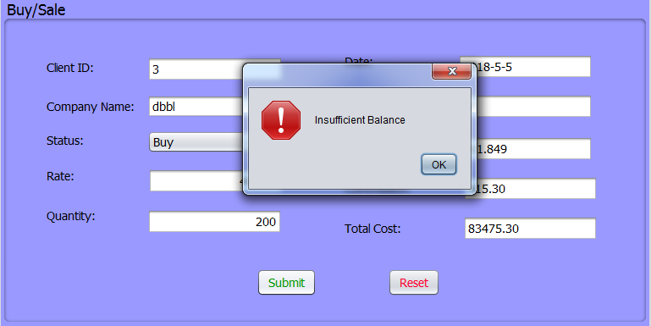
If client have not sufficient balance he/she can’t buy

Slide 9
He/she has to Deposit first
Go to Receipt Form

Slide 10
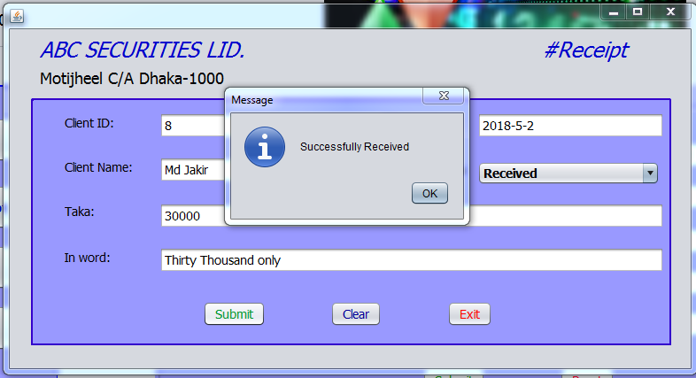
Client: 8 Deposit 30000 tk

Slide 11
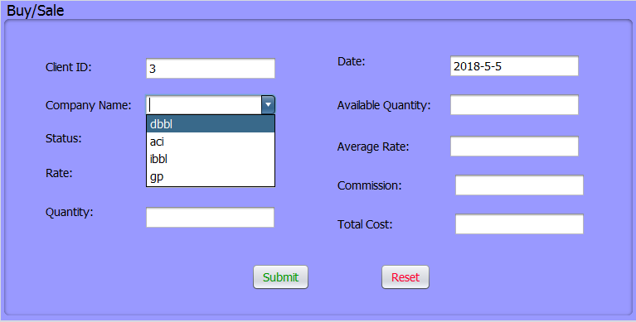
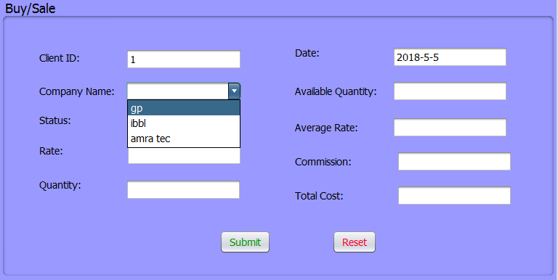
After input Client ID, Company Name combo box automatically load from database which item he /she have.
Client ID: 3
Client ID: 1

Slide 12
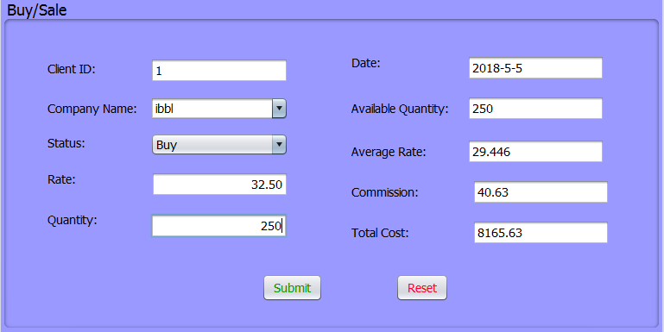
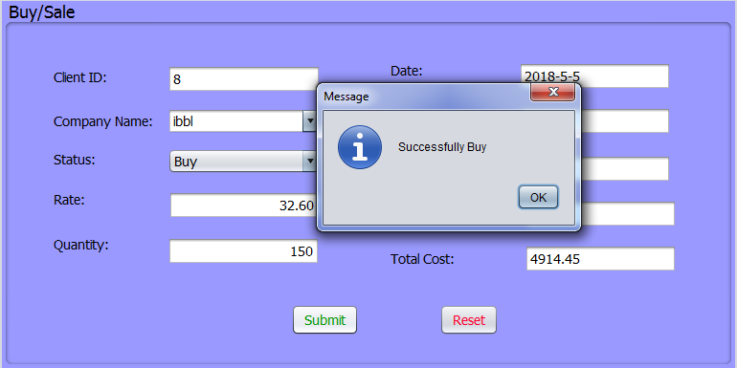
Commission and total cost calculate automatically after giving Rate and Quantity. Submit button successfully complete the transaction.

Slide 13
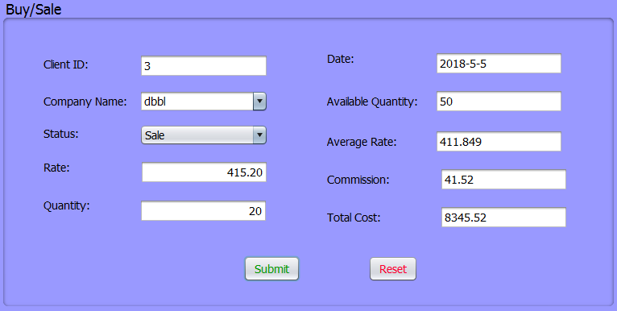
Available Quantity and Average Rate automatically load from database after changing status buy/sale.

Slide 14
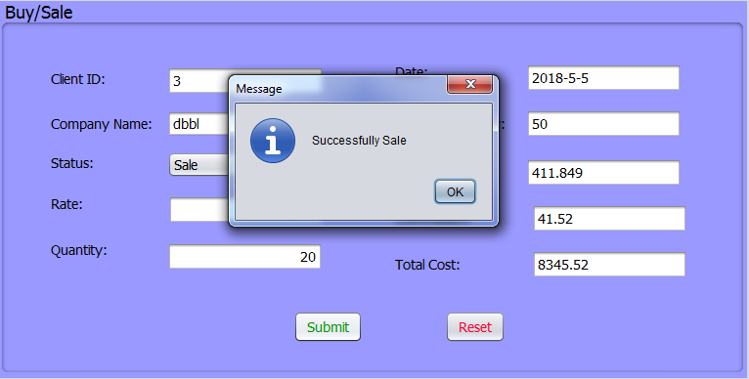
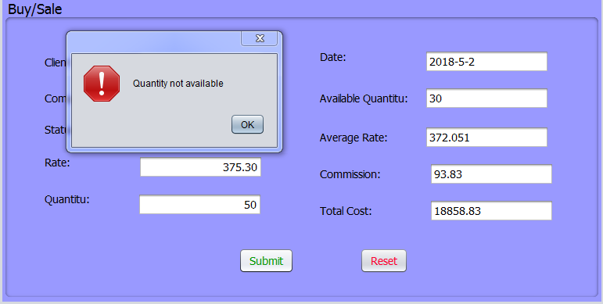
Submit button successfully complete the transaction. If client has not available quantity a warning massage displayed.

Slide 15
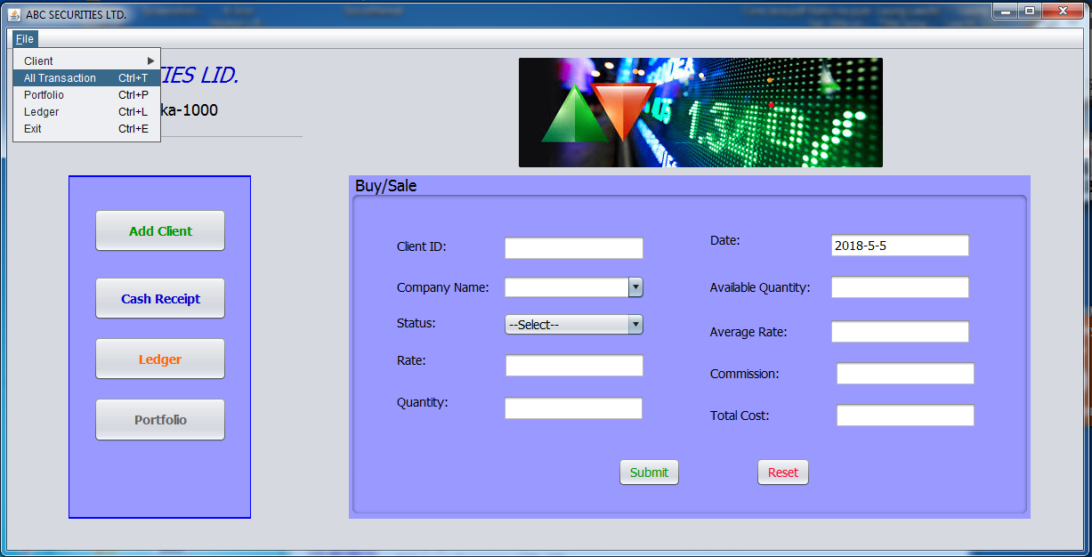
Go to All Transaction Form

Slide 16
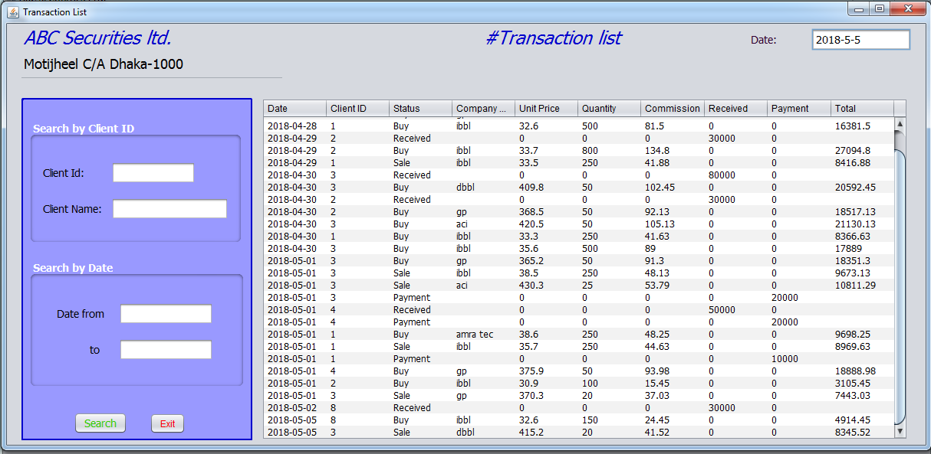

Slide 17
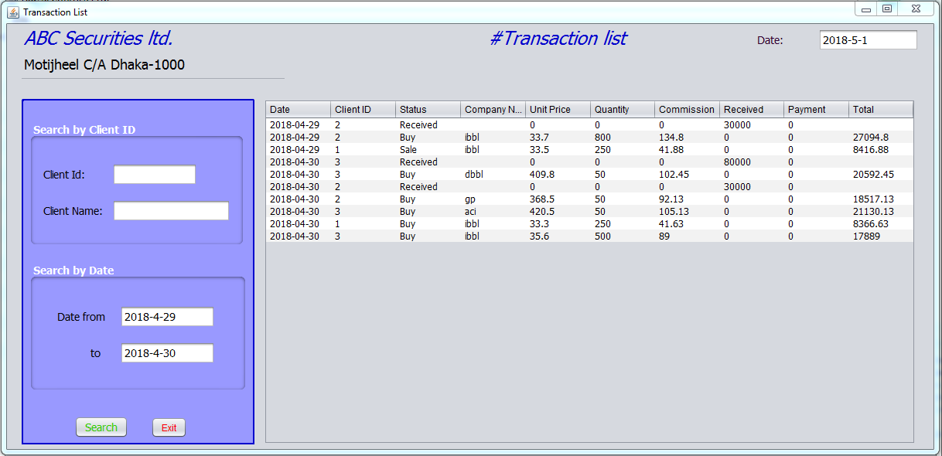

Slide 18
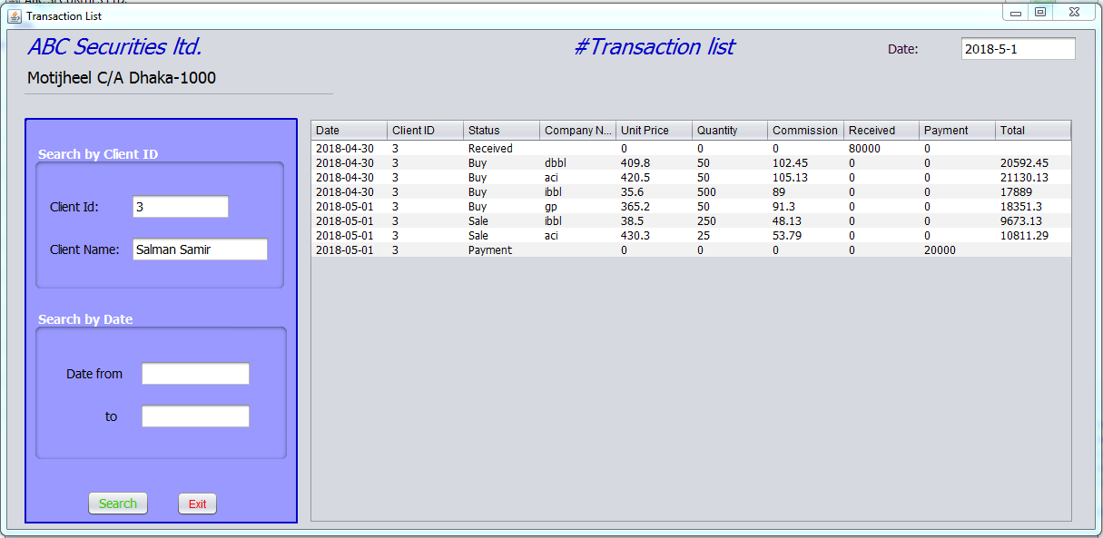

Slide 19
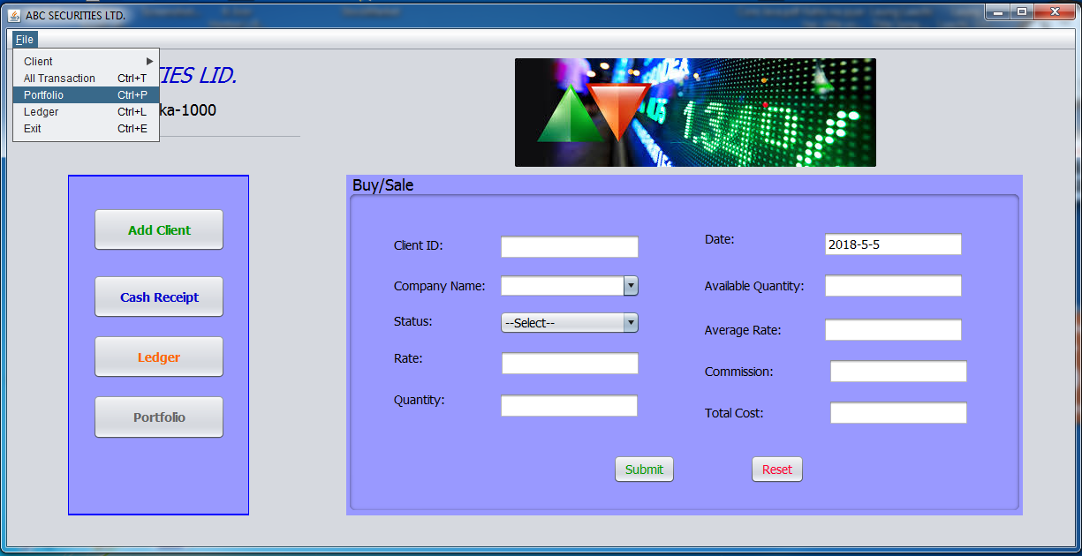
Go to Portfolio Form

Slide 20
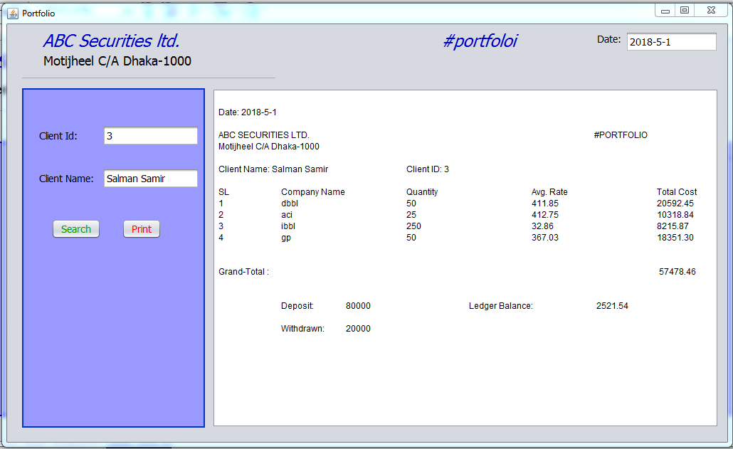

Slide 21

Go to Ledger Form

Slide 22
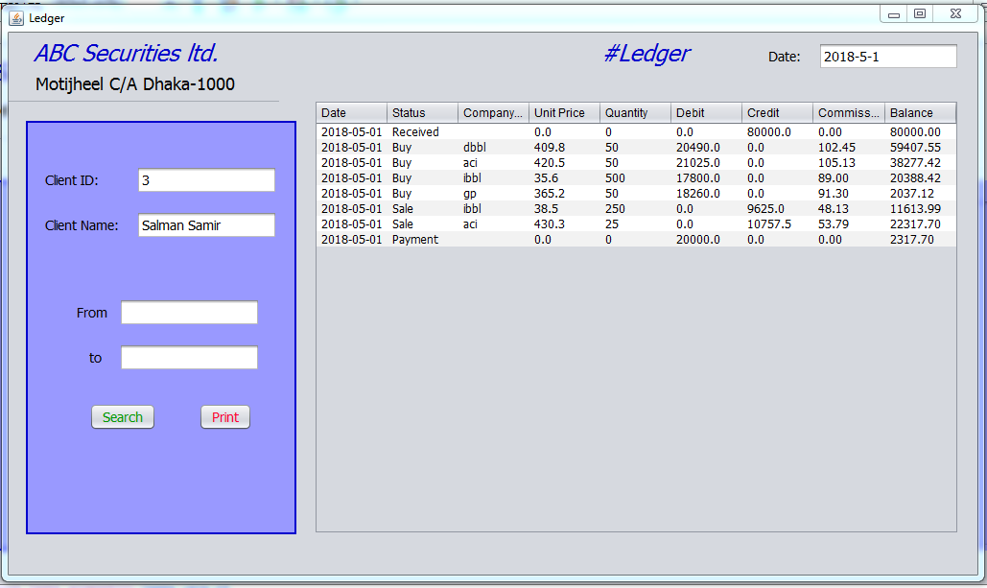

Slide 23
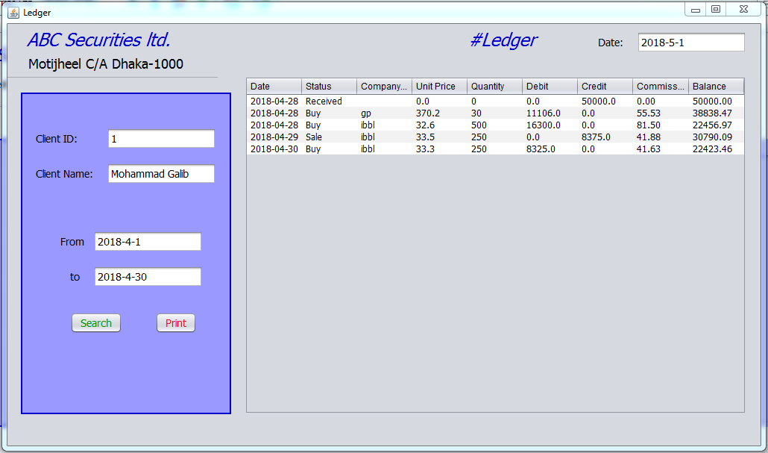

Slide 24

Exit from Application

